Slide 1

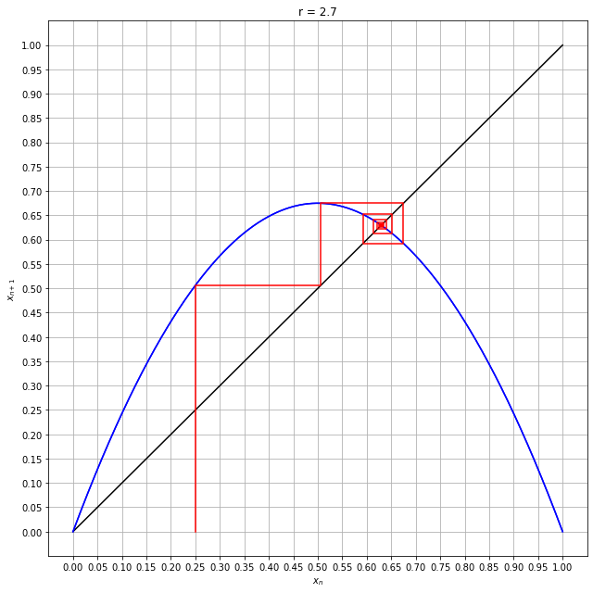
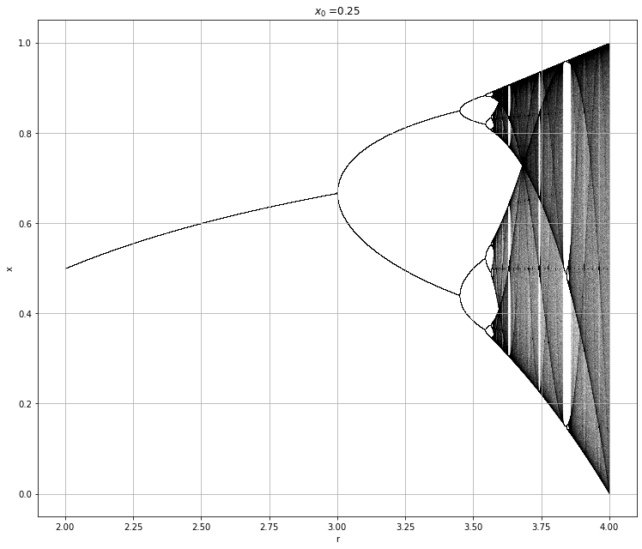
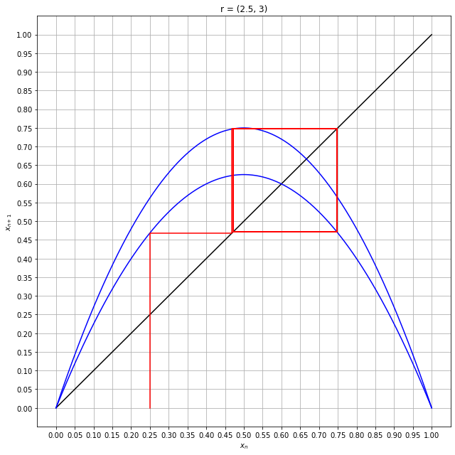
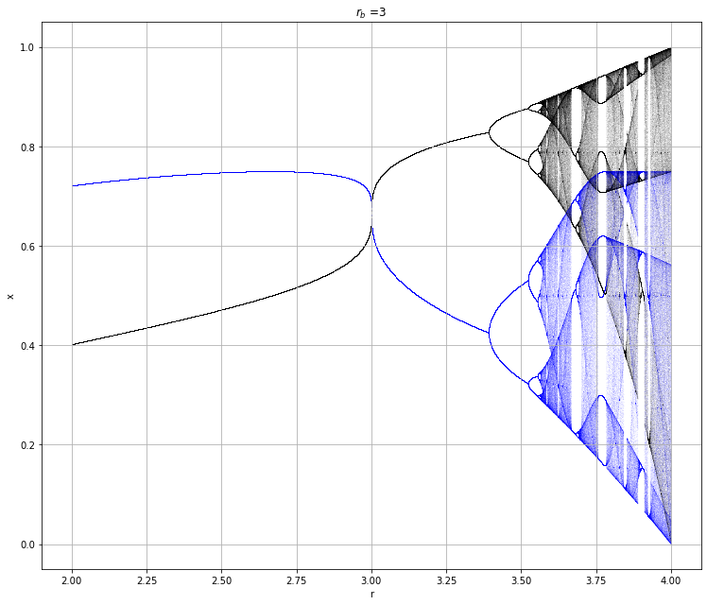
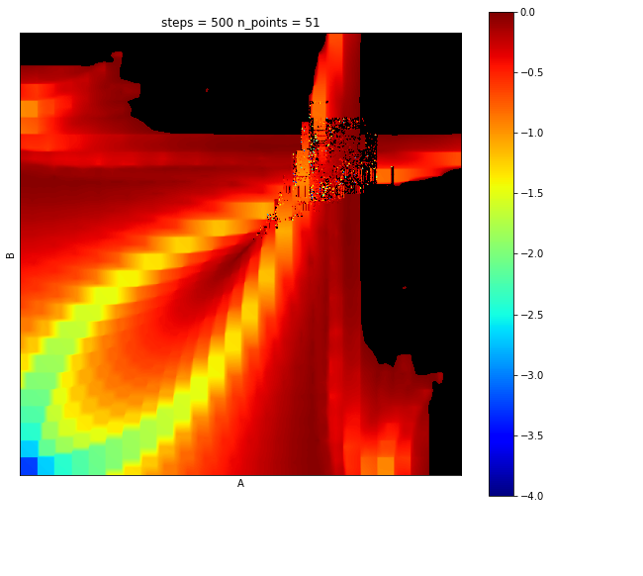
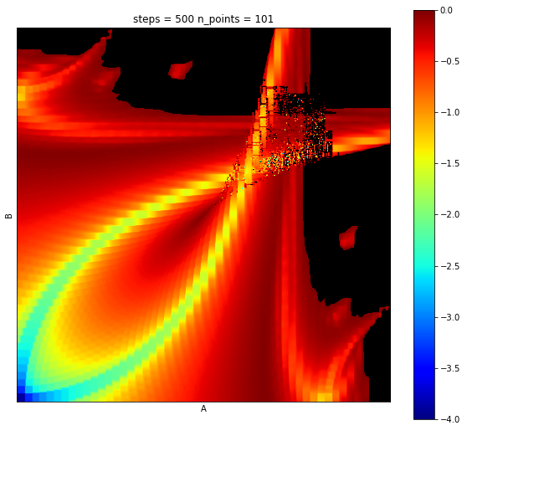

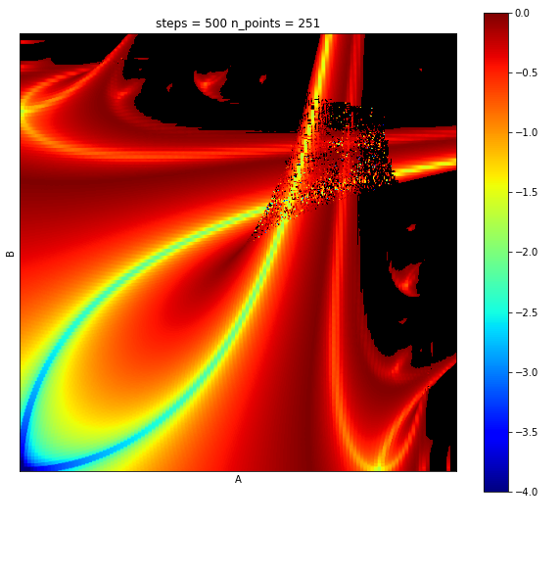
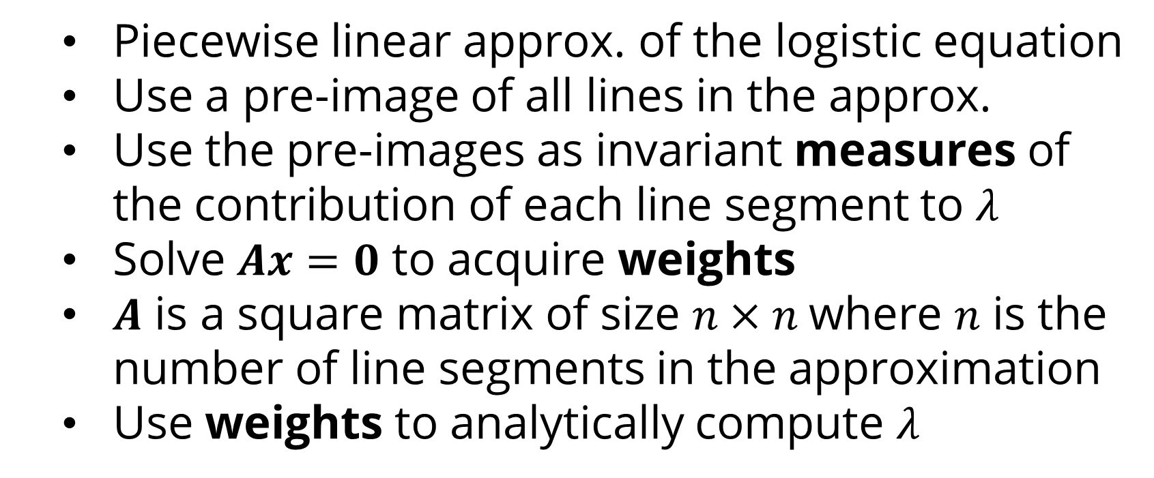
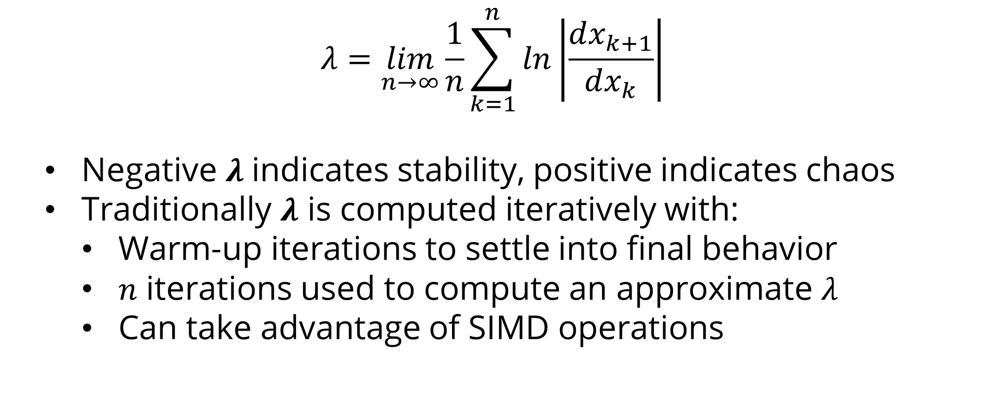
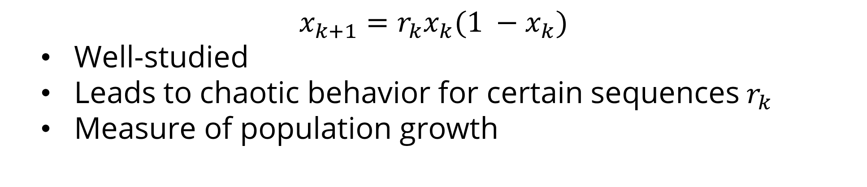
Invariant Measure Theory and Linear Approximations of Lyapunov Fractals Eric Botti and Shaun D. Ramsey, Ph.D. Department of Mathematics and Computer Science at Washington College
Abstract
Cobweb Plots and Bifurcation Plots
Invariants and Approximations
Actuators, sensors, and computational components may be controlled intermittently in time and, thus, inconsistently perform any given operation. The inconsistencies in control operation directly influence the time domain of the control system. Previously, it was shown that chaos can be introduced into a system by changing only the time domain. Previously it was also that chaos exists in stochastic time domains in the same system. Can chaos be appropriately predicted by estimating the controlling system via linear approximation and an assumption of invariant weights across the domain? We answer this question in the affirmative. Using this technique, computation of a traditional Lyapunov fractal, SuPeR fractal, or any iterative fractal, no longer involves iterating over the deterministic steps in the time series, but can be estimated by linearly approximating the underlying continuous system using a system of linear equations. We show, via experiment, that in the limit, this estimation is equivalent to the iterative method.
Piecewise linear approx. of the logistic equation
Use a pre-image of all lines in the approx.
Use the pre-images as invariant measures of the contribution of each line segment to $λ$
Solve $Ax=0$ to acquire weights
$A$ is a square matrix of size $n×n$where $n$ is the number of line segments in the approximation
Use weights to analytically compute $λ$
Conclusions
Shows rough convergence to iterative solution
Slower than iterative computations
Gives evidence to conjecture
Forced Discrete Logistic Equation
Future Work
$$x_{k+1}=r_{k}x_{k}(1 −x_{k})$$
Well-studied
Leads to chaotic behavior for certain sequences $r_{k}$
Measure of population growth
Improve upon the linear approximation
Show proof of conjecture related to convergence
Linear operators efficiency investigation
The Lyapunov Exponent and Iteration
$$λ=\lim_{n→∞}{\frac{1}{n}\sum_{k=1}^{n}{ln\left|\frac{dx_{k+1}}{dx_{k}}\right|}}$$
Negative $λ$ indicates stability, positive indicates chaos
Traditionally $λ$ is computed iteratively with:
Warm-up iterations to settle into final behavior
$n$ iterations used to compute an approximate $λ$
Can take advantage of SIMD operations

